Slide 1
Moving Westward
The American Pageant, Chapter 26

Slide 2
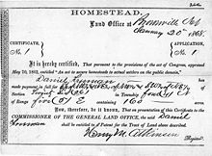
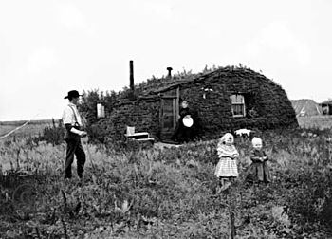
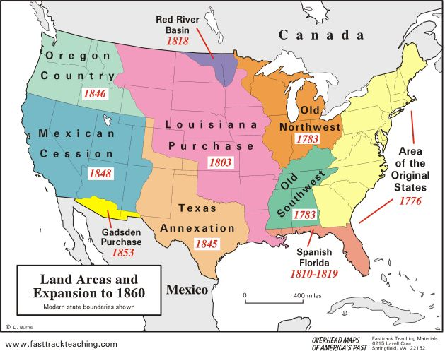
Westward Expansion
We’ve moved west already
Oregon territory—1830s
Utah—1847 (Mormons)
California—1848
Government promotes economic development of the West
Homestead Act**
Settlements increase, but difficult
Cost, mother nature, etc.
Pacific Railroad Act
Transcontinental Railroad
Money and land provided by government
Overuse of land—leads to conservation efforts**
Yellowstone, Yosemite, etc.

Slide 3
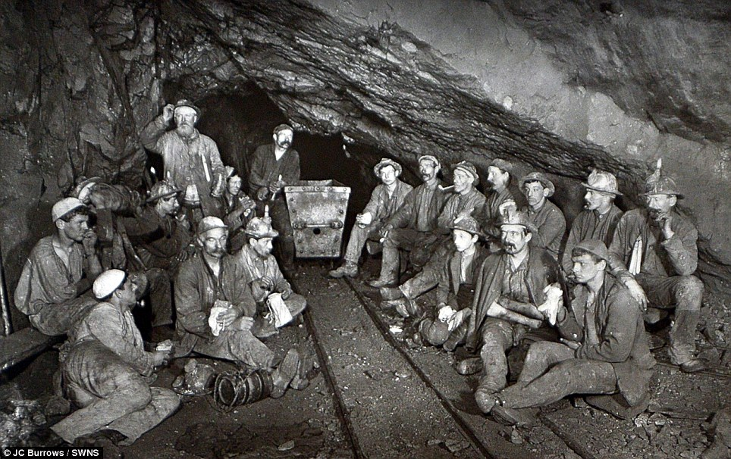
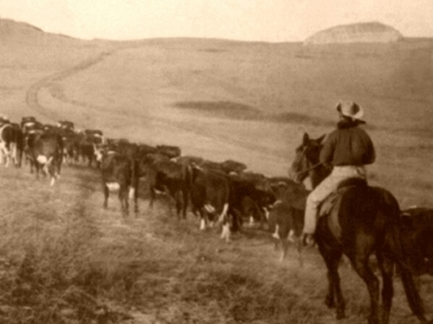
Economy of the West
Market is a roller coaster—booms and busts
Overproduction, weather, price fluctuation, etc.
Mining
Pikes Peak (CO), Comstock (NV)
High immigrant population
Harsh living conditions
Impact on Natives; Environment
Cattle**
Cowboys ran the business, grasslands
Railroad opens new markets
Dodge City, Abilene, etc.

Slide 4
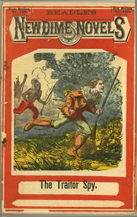
Life in the West
Dime novels
Present the west as “easier” and better than it was
Image of the Cowboy
Reality with Native Americans
“Melting Pot” –immigrants
Nativism
Cowboys—originally Mexican
Many are African-American
Utah comes in as a state in 1869
Women’s suffrage more evident (WY, UT, CO, ID)
19th Amendment*********************

Slide 5
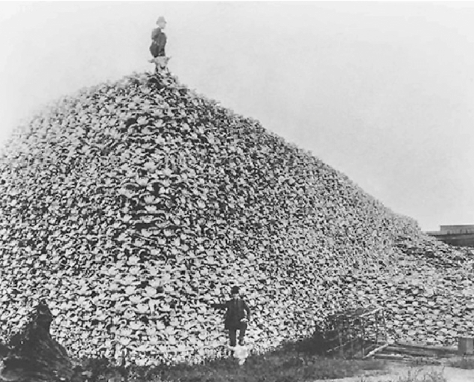
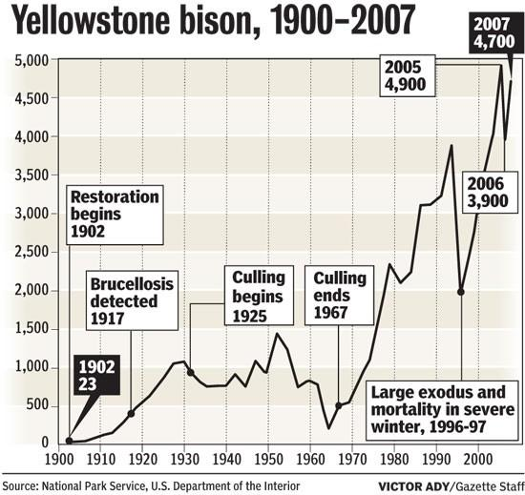
Life Out West
Impact on Native Americans
“Foot travelers” to horseback; disease, etc.
Plains Indians—many tribes
Conflicts with each other, settlers
Reliance on bison
Natives vs. Americans
Decrease in Bison population
Pressure and tension increases between Natives, Americans
Natives in trans-Mississippi West most impacted by expansion

Slide 6
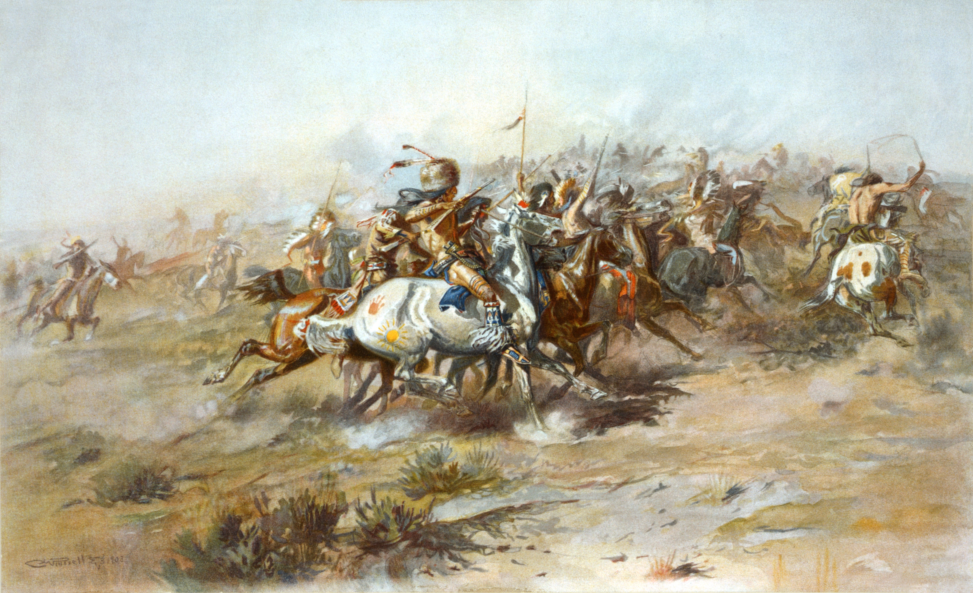
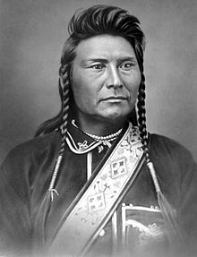
Ultimate Result: Indian Wars
Violence breaks out
Americans conquering “their” land, Natives defending their land
Sand Creek Massacre—1864
Colorado militia kills 100+ Natives
Battle of Little Big Horn—1876
Sioux tribe led by Sitting Bull
Native victory (2.500 v. 250)
Custer’s last stand
Chief Joseph leads Nez Perce tribe to Canada
Unsuccessful, 1877

Slide 7
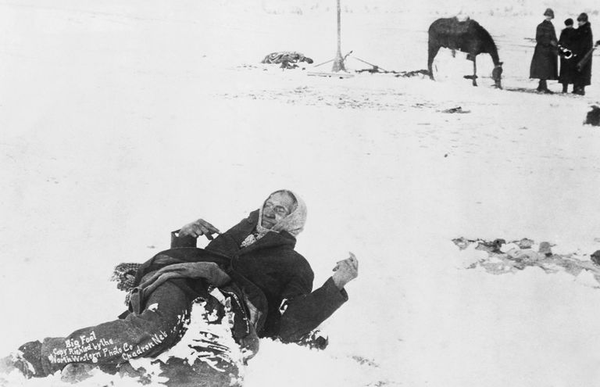
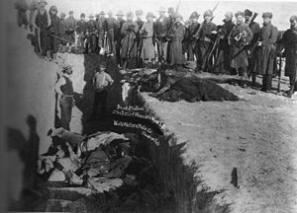
The Big Battle To Know: Wounded Knee
Sioux begin ghost dance movement
Religious Revival
Goal—rid settlers, return tribe and land to prosperity
Government shuts it down
Battle of Wounded Knee
Over 200 Natives Killed
Battle of Wounded Knee—end of American frontier wars

Slide 8
Assimilation**
Helen Hunt Jackson—A Century of Dishonor
Documents mistreatment of Natives
Gains “sympathy” points for Natives
Attempts to assimilate**
Dawes Act
Reservations—private farms for Natives
Leave us alone, and we’ll agree—didn’t work out that way
Receive citizenship if adopting “civilized” life
Carlisle Indian School

Slide 9
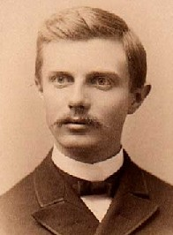
Closing the Frontier
Oklahoma opened for settlement, 1889
Boomer Sooner
Land rush
Frederick Jackson Turner
Significance of the Frontier in American History
Frontier ends in 1890
Frontier’s importance to our identity
Move west in times of difficulty
Truth is—by 1890—people are moving back to urban areas
1890s—continued overseas expansion
Imperialism**

Slide 10
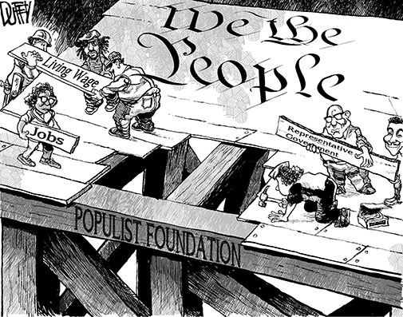
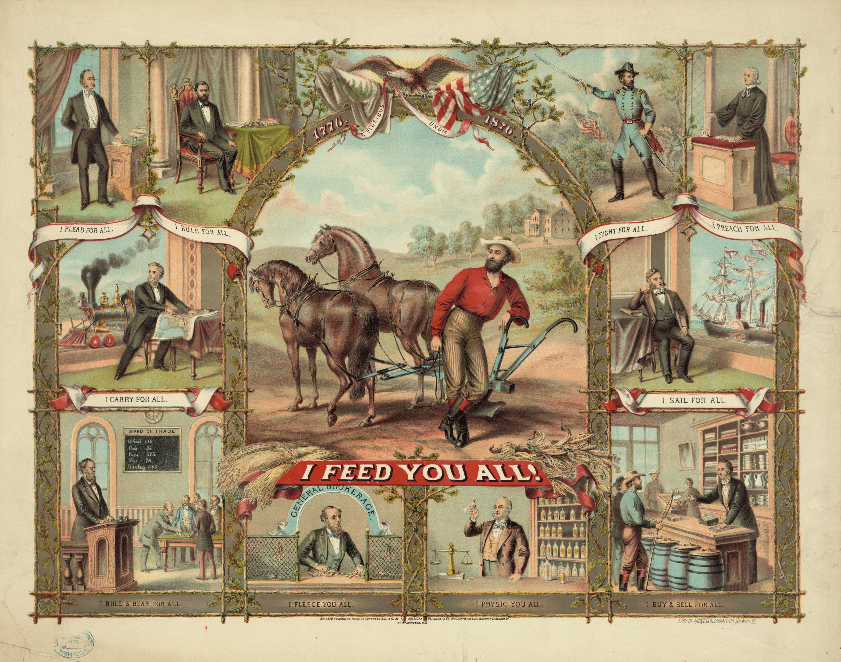
Farmers Organize
Farming more commercialized; mechanical
Problems facing farmers:
Price fluctuation,
Business practices (RR)
Cost of machinery
Little access to “hard” money
Tariffs
Leads to the Grange Movement**
Call for social and economic reforms
Call for government regulation (lobbying)**

Slide 11
Farmers Organize
Reform Efforts Include—
Munn v Illinois—states regulate railroad
Wabash Case—overturns Munn
Leads ultimately to Interstate Commerce Act
Farmers Alliance (segregated group)
Rise of Populist Party**
Government ownership of RR
Free coinage of silver**
Calls for an income tax (16th Amendment)**
Calls for direct election of senators (17th Amendment)**
Calls for direct participation in the democratic process**
Initiative, Referendum, Recall**

Slide 12
Towards the End of the 19th Century
Frustration with capitalist system
Laissez-faire protects the powerful and rich
What about the rest?
Similar in kind…
Panic of 1893—economic crash—government stays “laissez-faire”
The poor start to organize further
Labor Unions form—seek better treatment, hours, wages**
Organize strikes**
Homestead Strike (Carnegies steel plants)—unsuccessful
Panic of 1893—market crashes

Slide 13
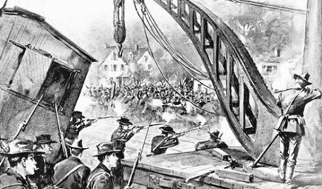
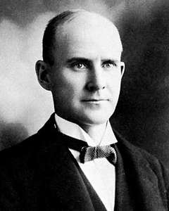
Calls for Change
Coxey’s Army—1894
Demands for government jobs for the unemployed
Pullman Strike
Strike by Eugene Debs and American Railway Union
Shut down by troops, President Cleveland

Slide 14
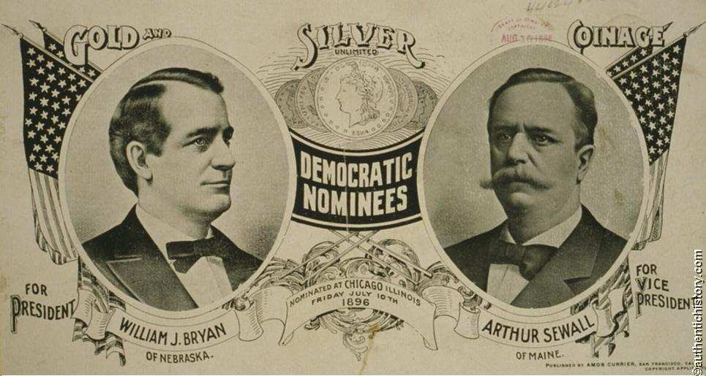
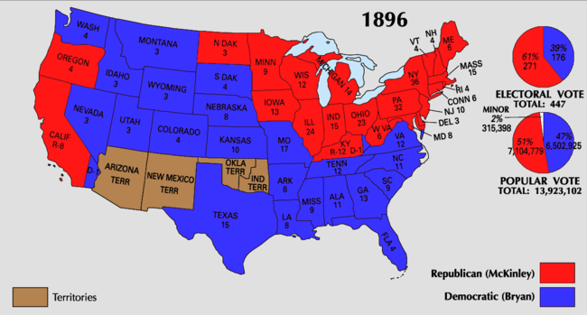
Election of 1896
William McKinley** v. William Jennings Bryan**
WJB
Cross of Gold Speech**
Calls for socialist, populist change
McKinley (R) wins the election

